Slide 1
Database Design
C393: Database Systems

Slide 2
Review

Slide 3
Lesson Objectives
Interpret a design diagram
Convert a design diagram into a sentence
Convert a sentence into a design diagram
Apply best practices to design diagrams

Slide 4
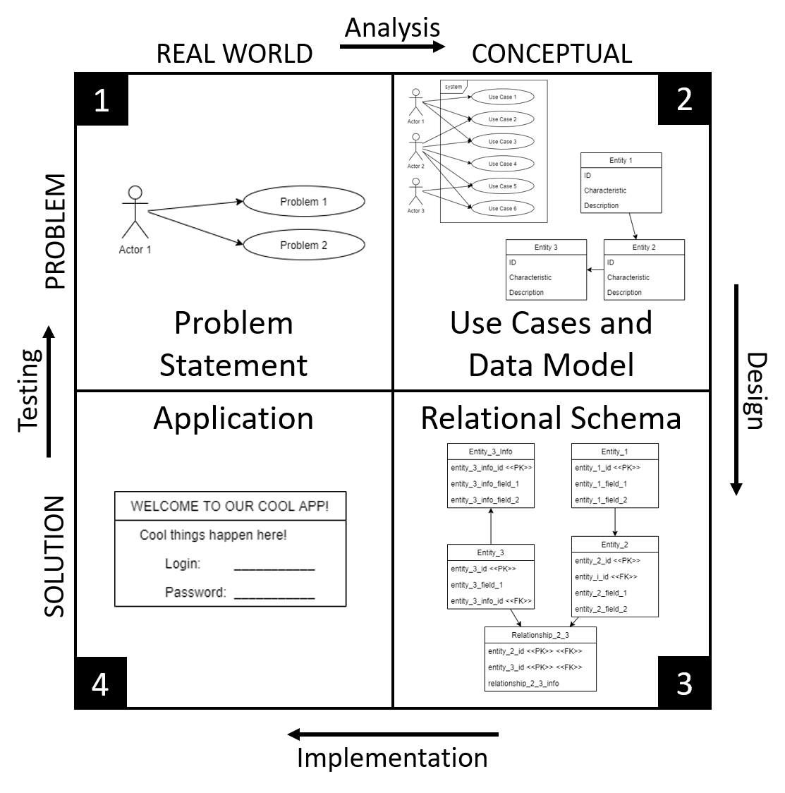
Iterative Design Process
Real World Problem
Problem Statement
Abstract Problem
Use Cases
Data Model
Conceptual Solution
Relational Schema
Interface Design
Implemented Solution
Database
User Interface
Adapted from Zelkowitz et al. 1979
Notes:
What is the point of CS393?
- Teach you to think (like a scientist/engineer)
- Iterative design process
Why do we need a design process? – where else have you used a process?
- It works (tested way to cover all the usual issues)
- Do it right or do it twice / measure twice, cut once / if you don't have time to do it right, when will you have time to do it over?
- Builds documentation for future work
How does this match other design processes you've worked with?
- Situation -> Analysis -> Solution Design -> Solution Implementation -> Test
First we want to understand what is the problem we are trying to solve; we may have a customer we are working with
Objective – what is the goal of this system we are trying to build?
Situation – what does this thing need to do? What are we trying to model?
Use Cases – who are the actors using this system and what do they need the system to do?
Data Model – abstract model of the entities and relationships described in the problem statement
Relational Schema – we take the data model and refine it define a relational database: data types, referential integrity, required/optional attributes
Application: schema implemented using a database management system and then incorporated into a LAMP server
Today we will focus on the Problem Statement
Note that the length of the arrows on the diagram has *nothing* to do with relative weight of each step (analysis, design, implementation, and testing).
They're just however long they fit.

Slide 5
But…
We’re not there yet…

Slide 6
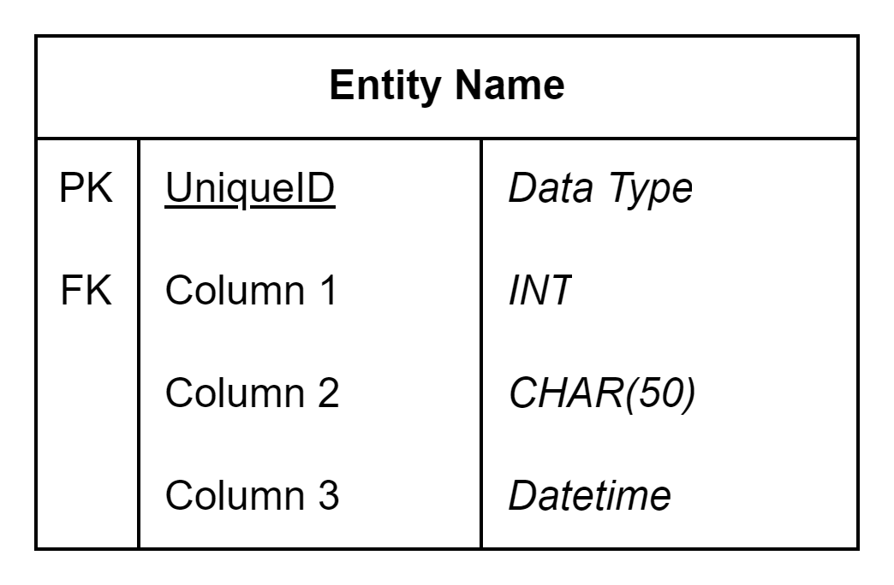
Design Diagrams

Slide 7
My SQL Data Types
Where do we find those?
MySQL :: MySQL 8.0 Reference Manual :: 13 Data Types
Hmmm
How about… MySQL Data Types (w3schools.com)
Which one do I choose?

Slide 8
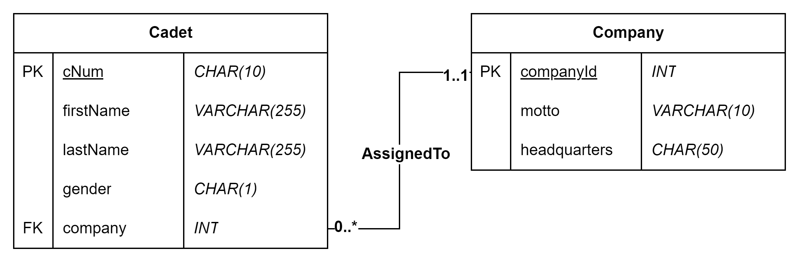
An Example

Slide 9
Cardinality vs Participation
Cardinality – degree (size) of multiplicity (upper bound)
Participation – mandatory or optional (lower bound)

Slide 10
Cardinality & Participation
Notes:
What is the cardinality of Cadet -> Company?
Company -> Cadet?
What is the participation?

Slide 11
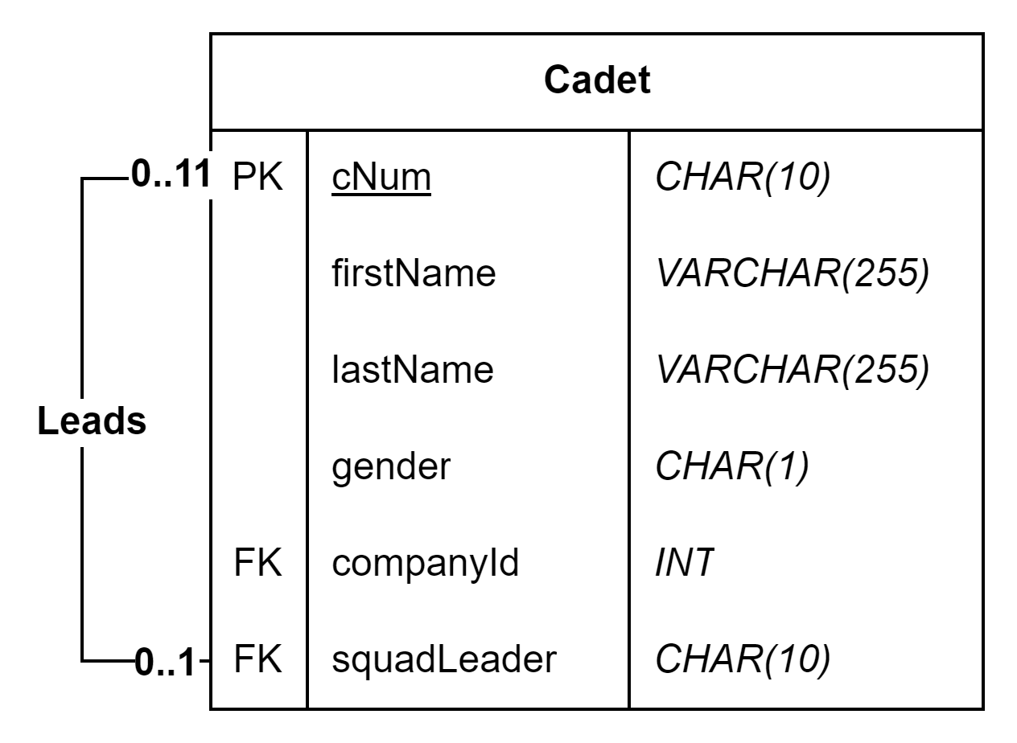
Another Example

Slide 12
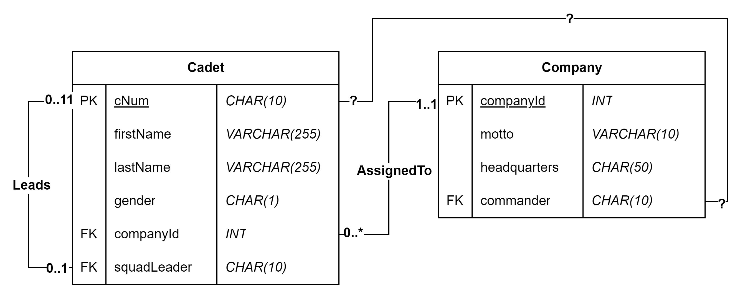
Another Example

Slide 13
In Class Exercise 1
Design a diagram for the following cases with at least three attributes…
Pet – Owner
Player – Team
Country – City
Room – Building
BankAccount – Transactions
Movie – Actor

Slide 14
Basic Principles

Slide 15
Basic Principles
Each cell should only hold one value* (How does this differ from the reading?)
Data not dependent on the PK should be in a separate table.
Data types should help enforce business rules
Could store dates as text, why don’t we?
Data types should help limit transaction and record sizes
If you use CHAR(50), each record will take 50 bytes of storage
How large is a bank transaction database?
We will talk more about these and more in future lessons
Notes:
*exception with the SET datatype

Slide 16
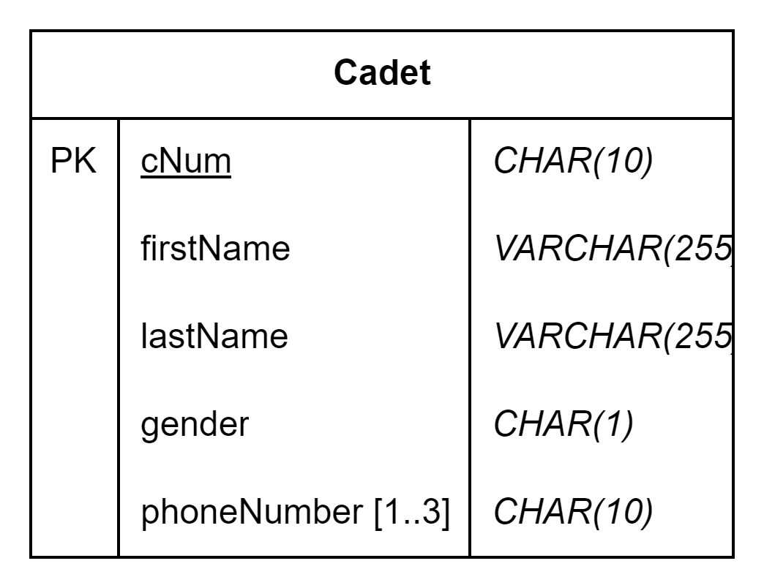
Each cell should only hold one value
cNum | firstName | lastName | gender | phoneNumber
c123456789 | John | Doe | M | 1234567890
c123456789 | John | Doe | M | 1234567891
c123456789 | John | Doe | M | 1234567892
Notes:
The book calls phoneNumber a multi-valued attribute

Slide 17
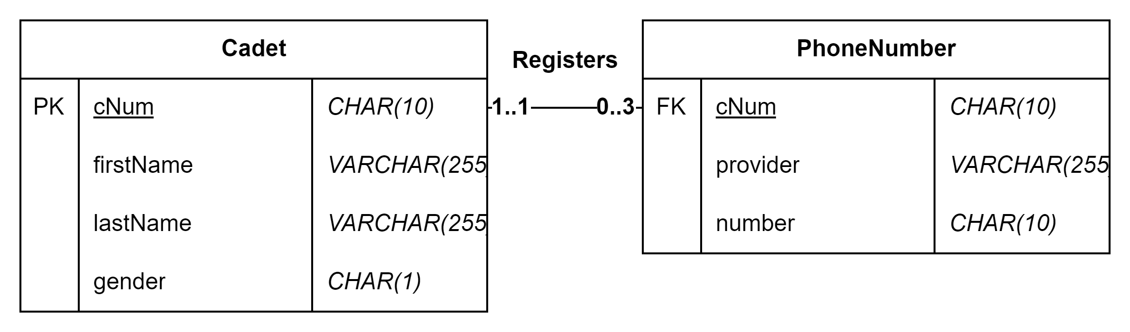
Each cell should only hold one value
cNum | firstName | lastName | gender
c123456789 | John | Doe | M
cNum | provider | number
c123456789 | Verizon | 1234567890
c123456789 | AT&T | 1234567891
c123456789 | T-Mobile | 1234567892

Slide 18
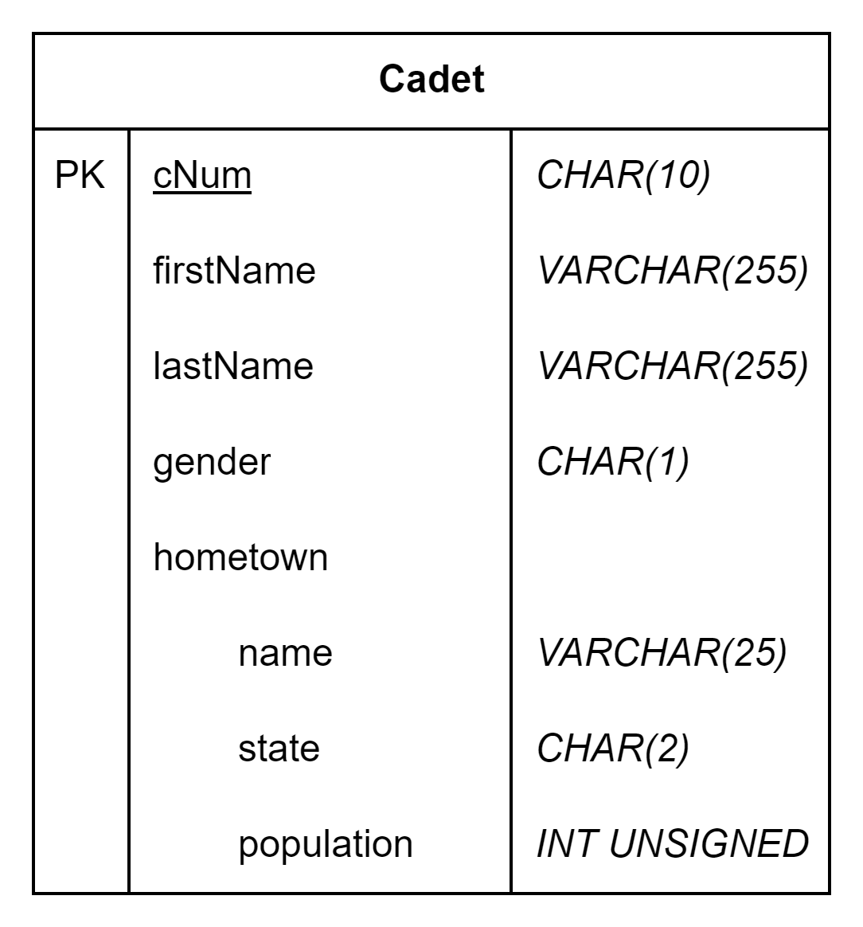
Data not dependent on the PK should be in a separate table.
cNum | firstName | lastName | gender | hometownName | hometownState | population
c123456789 | John | Doe | M | Sioux Falls | SD | 200000
c123456788 | Jane | Smith | F | Sioux City | IA | 85000
c123456787 | Mark | Johnson | M | Minneapolis | MN | 430000
c123456786 | Jessie | Smith | M | Sioux Falls | SD | 200000
Notes:
What is the technical name for the “hometown” attribute?

Slide 19
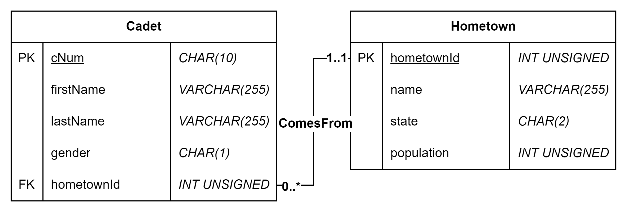
Data not dependent on the PK should be in a separate table.

Slide 20
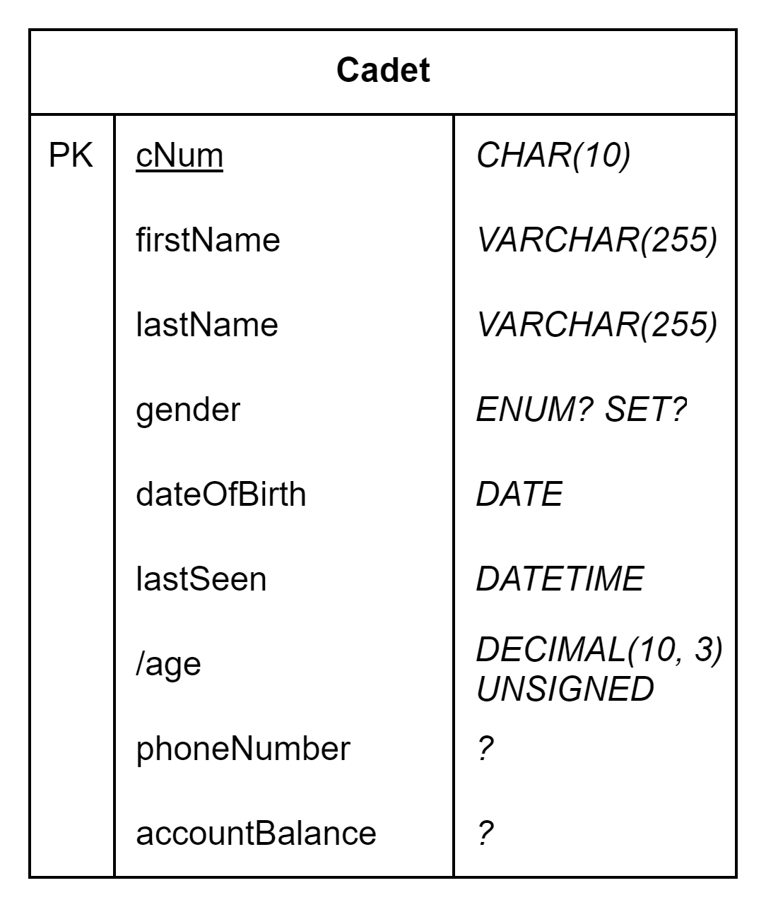
Data types should help enforce business rules

Slide 21
Data types should help limit transaction and record sizes
Notes:
Gender here is either M or F, no need to store any more info
A cNum is always 10 characters
A phone number is always 10 characters
Names might be of variable length
As an example: VARCHAR(255) cNum * 1,000,000 records = 1,000,000 extra bytes of storage / memory
CHAR(10) cNum * 1,000,000 = 0 extra bytes of storage / memory

Slide 22
Why do we even need data types?
How is data stored on computers?

Slide 23
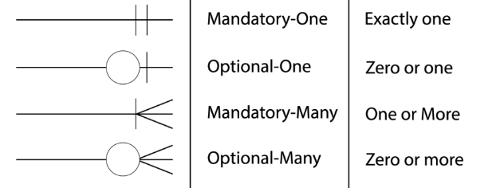
A Note on Crow’s Foot
Notes:
In case you run into crow’s foot anywhere else

Slide 24
Exercise Breather

Slide 25
In Class Exercise 2: Small Word Problems
Library: Author, Book, Customer, Employee
Online Store: Customer, Product, Order, Address
Hospital: Patient, Doctor, Appointment, Condition
Ticketmaster: Venue, Performer, Customer, Ticket
Fitness Center: Member, Trainer, Class
Access System: Role, Privileges, Users, Objects
Notes:
Create diagrams with appropriate tables, relationships, and data types on the boards
Make sure to follow the 4 basic principles that were outlined

Slide 26
Draw.io
I recommend starting from the “lesson02 diagrams.drawio” file on Canvas
Ctrl+Enter to add new rows
Slowly click twice on a cell then press delete to delete a row
Use the right-hand pane to modify lines

Slide 27
Final Exercise
Download scenario from Canvas
Use draw.io (or another diagram software) to diagram the database design. Submit it with your review for a bonus 2 pts.

